Slide 1
Passage au screening HPV primaire versus Co- Testing: importance diagnostique et analyse coût- bénéfice du couplage à la cytologie
PROF. DR. M. PRAET (UGent, UZA, AML)

Slide 2
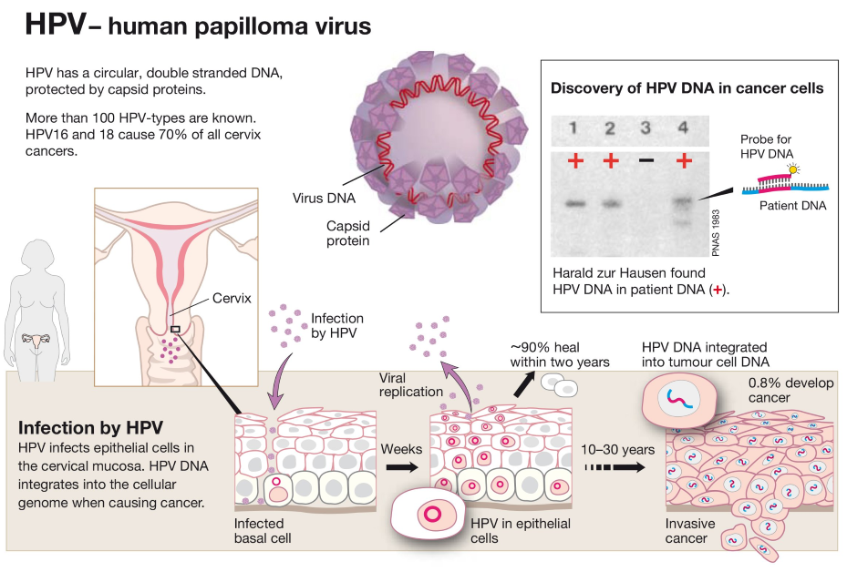
Introduction: Human papillomavirus (HPV) overview

Slide 3
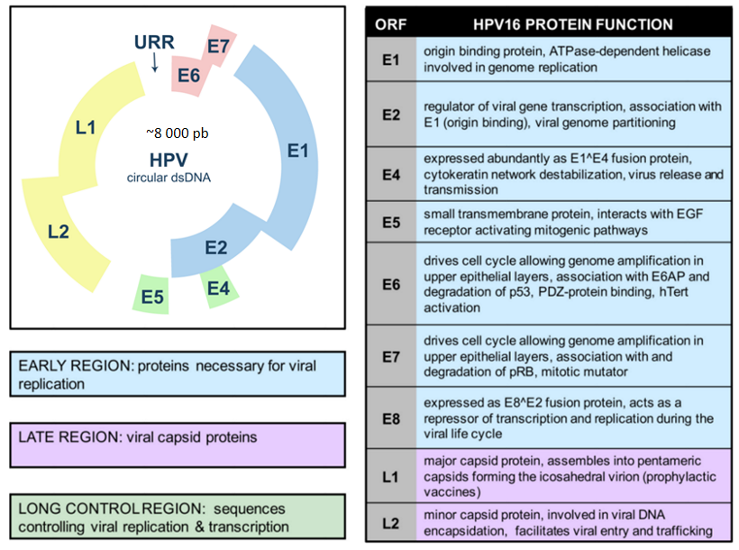
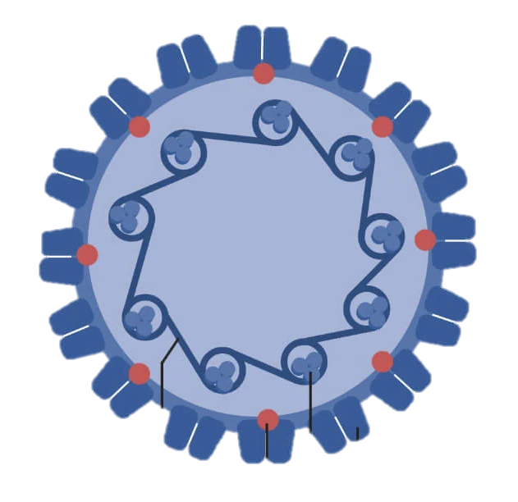
Introduction: HPV virology
Structure 3D of HPV (icosahedral capsid):
  Circular genomic DNA
  9 genes (E & L)
  Capside protein (L2)
  Capside protein (L1)
  Histone

Slide 4
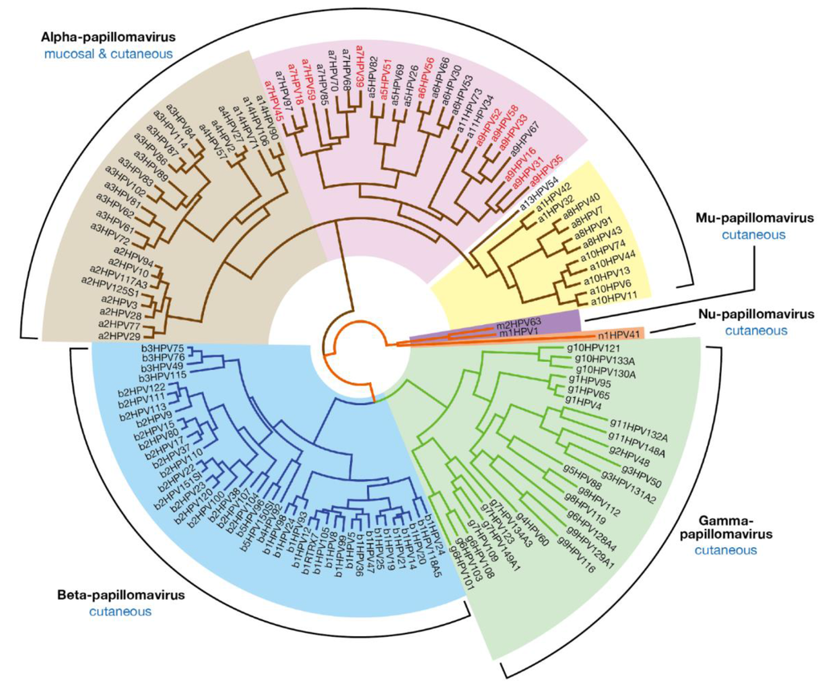
Introduction: HPV virology
  Large family of viruses: Approx. 250 types: mucosal/dermal, oncogenic/warts

Slide 5
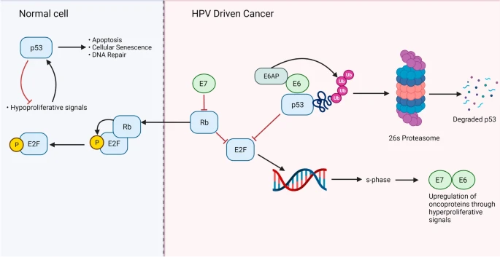
Introduction: HPV viral mechanism
Notes:
Infection with an HPV virion
Binds to cellular receptors (uncompletely known)
Alpha integrins
Laminins
Internalization via the host cell pathways (uncompletely known)
Retrograde transport to the nucleus
Integration of the viral genome in the host cell genome
Loss of E2 gene during integration
E2 is a suppressor gene, controling function of E6 and E7

Slide 6
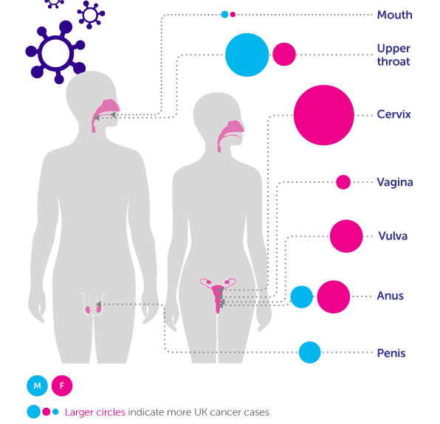
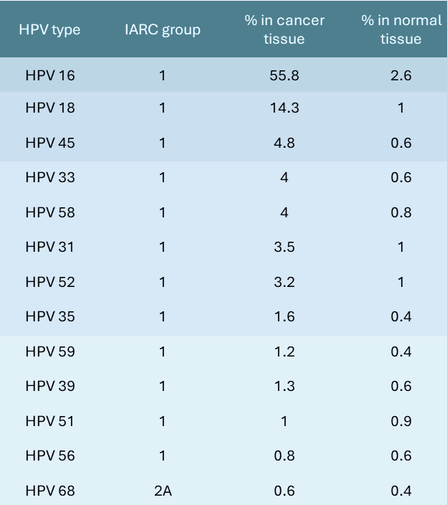
Introduction: HPV Carcinogenesis
HPV-induced cancers:
  13 high-risk HPV types: HPV 16,18,31,33,35,39,45,51,52,56,58,59,68
  7 potential high-risk types: HPV 26, 53, 66, 67, 70, 73, 82

Slide 7
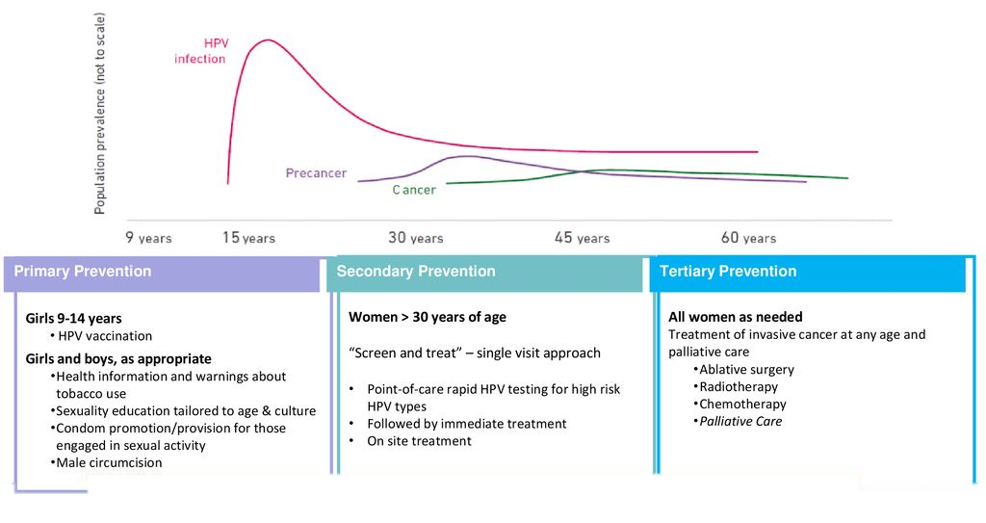
Prevention strategy: current situation strategy: current
BE: school vaccination at 12 y
BE: official screening between 25 - 60 y
Cervarix
Gardasil 4
Gardasil 9
Invitation letter (CVKO) to women 25-64 year
Normal scheme: 3-year interval
Cytology with HPV-reflex test

Slide 8
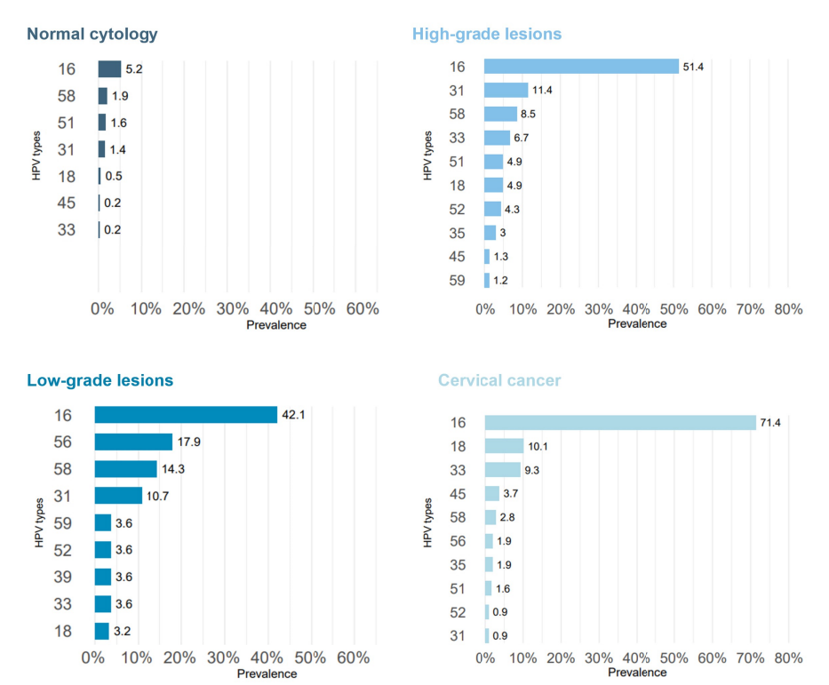
Introduction: cervical cancer epidemiology
HPV-types prevalence in healthy and diseased population

Slide 9
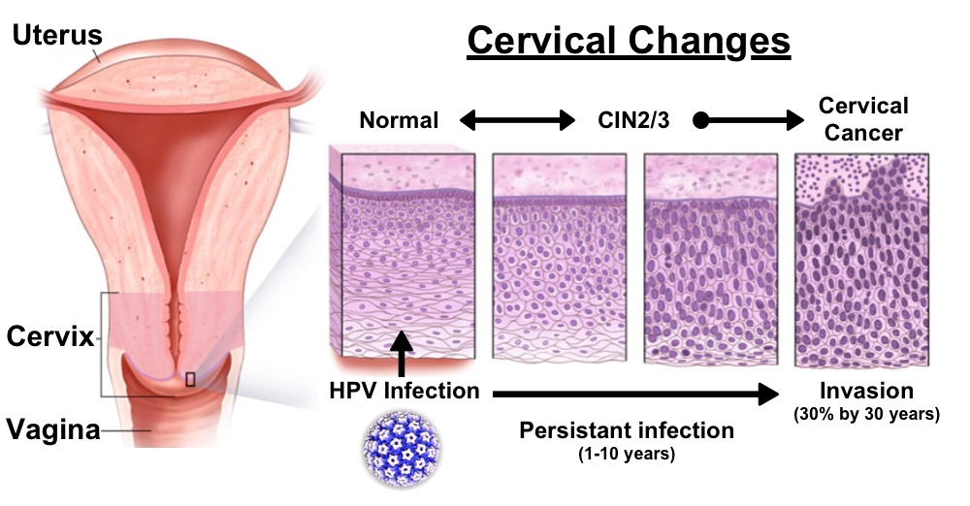
Introduction: HPV infection- cure or progression
Notes:
HPV infects at the transformation zone between the columnar epithelium of the vagina and the squamous epithelium of the cervix
Infects the basal cells
Productive infection: maturation with the cells of the squamous epithelium
Carcinogenic infection: integration in the host genome

Slide 10



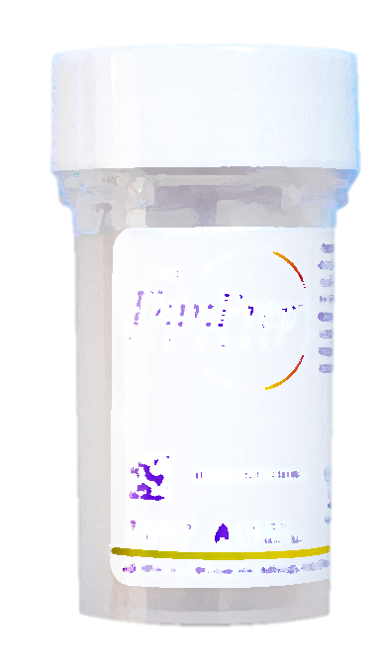
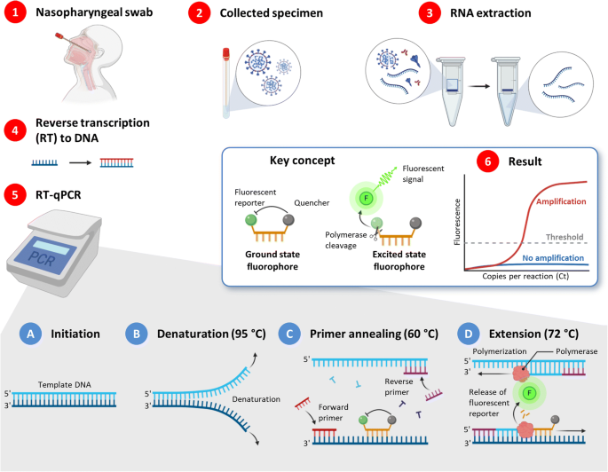
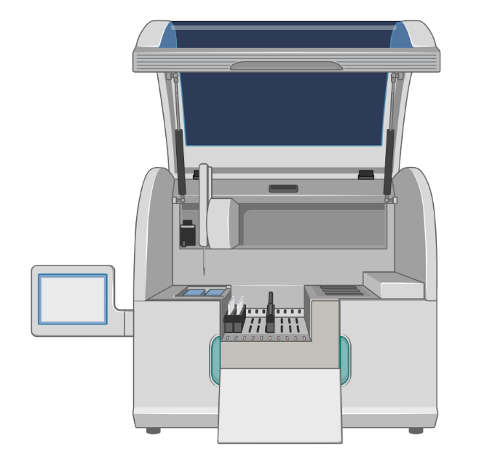
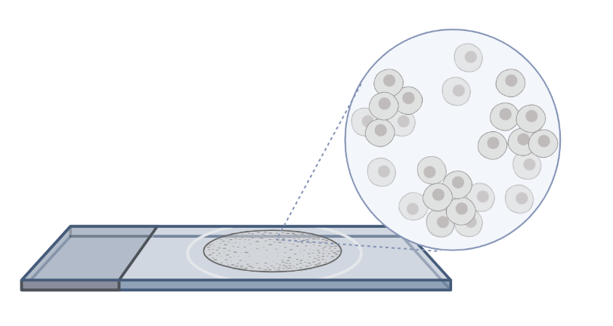
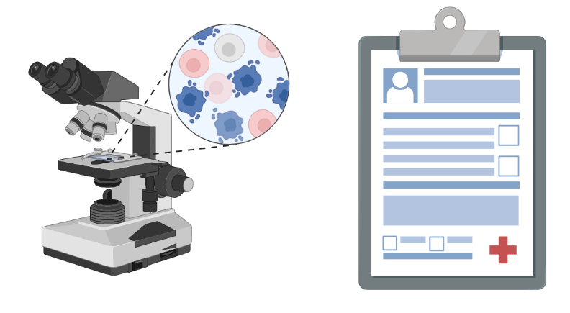
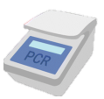

Prevention strategy conducted in AML
Since 2006 HPV/cytology co-testing:
Collect specimen
Nucleic acid extraction and RT-PCR
LBC cytology
Viral type and load quantification
More than 1M cases
    Hologic Thinprep ®
    Automated cytology pre-screening using Imager

Slide 11
Prevention strategy conducted in AML Prevention strategy: the Belgium experience (AML)
Since 2006 HPV/cytology co-testing:
Collect specimen
Nucleic acid extraction and RT-PCR
LBC cytology
Viral type and load quantification
More than 1M cases
    Hologic Thinprep ®
    Automated cytology pre-screening using Imager

Slide 12
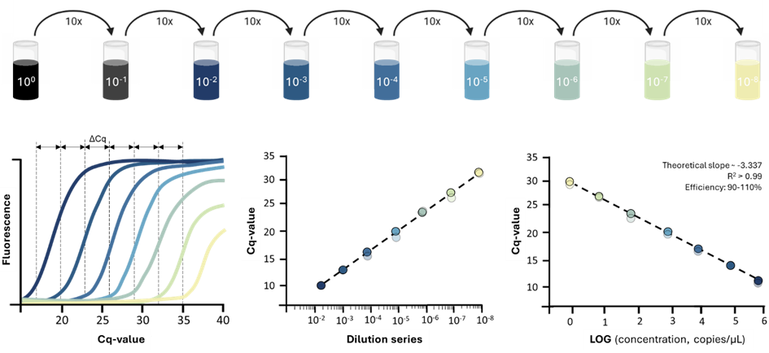
Prevention strategy conducted in AML Prevention Prevention strategy: the Belgium experience (AML)
In-house RIATOL qPCR: wide-genotyping workflow
HPV type | IARC group | % in cancer tissue | % in normal tissue | Attributable fraction, %
HPV 16 | 1 | 55.8 | 2.6 | 62.4
HPV 18 | 1 | 14.3 | 1 | 15.3
HPV 45 | 1 | 4.8 | 0.6 | 4.8
HPV 33 | 1 | 4 | 0.6 | 3.9
HPV 58 | 1 | 4 | 0.8 | 3.7
HPV 31 | 1 | 3.5 | 1 | 2.9
HPV 52 | 1 | 3.2 | 1 | 2.6
HPV 35 | 1 | 1.6 | 0.4 | 1.4
HPV 59 | 1 | 1.2 | 0.4 | 0.9
HPV 39 | 1 | 1.3 | 0.6 | 0.8
HPV 51 | 1 | 1 | 0.9 | 0.2
HPV 56 | 1 | 0.8 | 0.6 | 0.2
HPV 68 | 2A | 0.6 | 0.4 | 0.2
HPV 67 | 2B | 0.3 | 0.2 | <0.1
HPV 53 | 2B | 0.5 | 1.1 | NA
HPV 66 | 2B | 0.3 | 0.6 | NA
Amplification of the beta-globin gene is used for cellularity control on every sample and viral load quantification:
Nr. cells =
DNA concentration (ng per µL)
weight human genome (ng per cell)
CALCULATED FROM STANDARD CURVES
Viral load =
HPV concentration (copies per µL)
Nr. cells
Standard curves from synthetic gene fragments per HPV-target specific:
Group 1: carcinogenic; Group 2A: probable carcinogenic; Group 2B: possibly carcinogenic.

Slide 13
Prevention strategy conducted in AML
Since 2006 HPV/cytology co-testing:
Collect specimen
Nucleic acid extraction and RT-PCR
LBC cytology
Viral type and load quantification
More than 1M cases
    Hologic Thinprep ®
    Automated cytology pre-screening using Imager

Slide 14

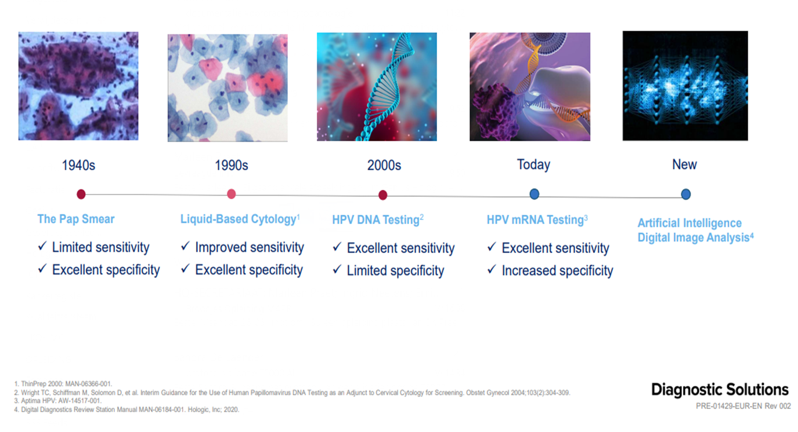
Prevention strategy conducted in AML
Cervical cancer screening technology – Hologic®

Slide 15
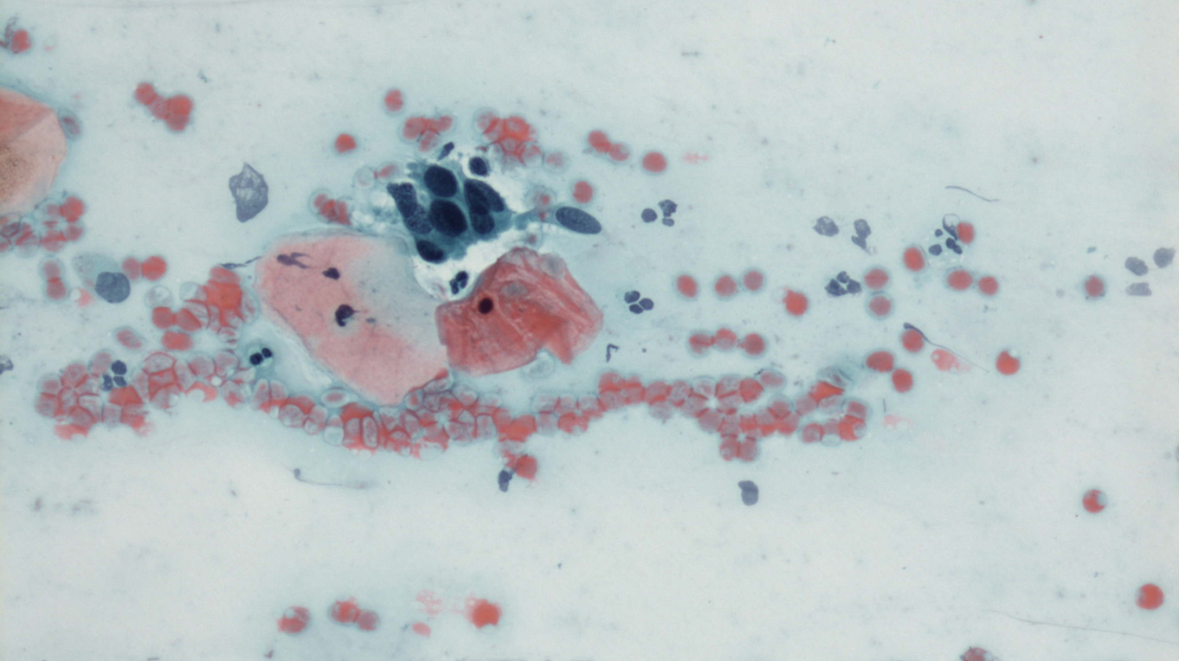
Prevention strategy conducted in AML
Conventional smear cytology and Papanicolaou classification
Conventional smears:
low sensitivity
high specificity
difficult to read due to background contamination of germs, infection (Gardnerella), mucus, blood, etc.
cheap to implement!

Slide 16
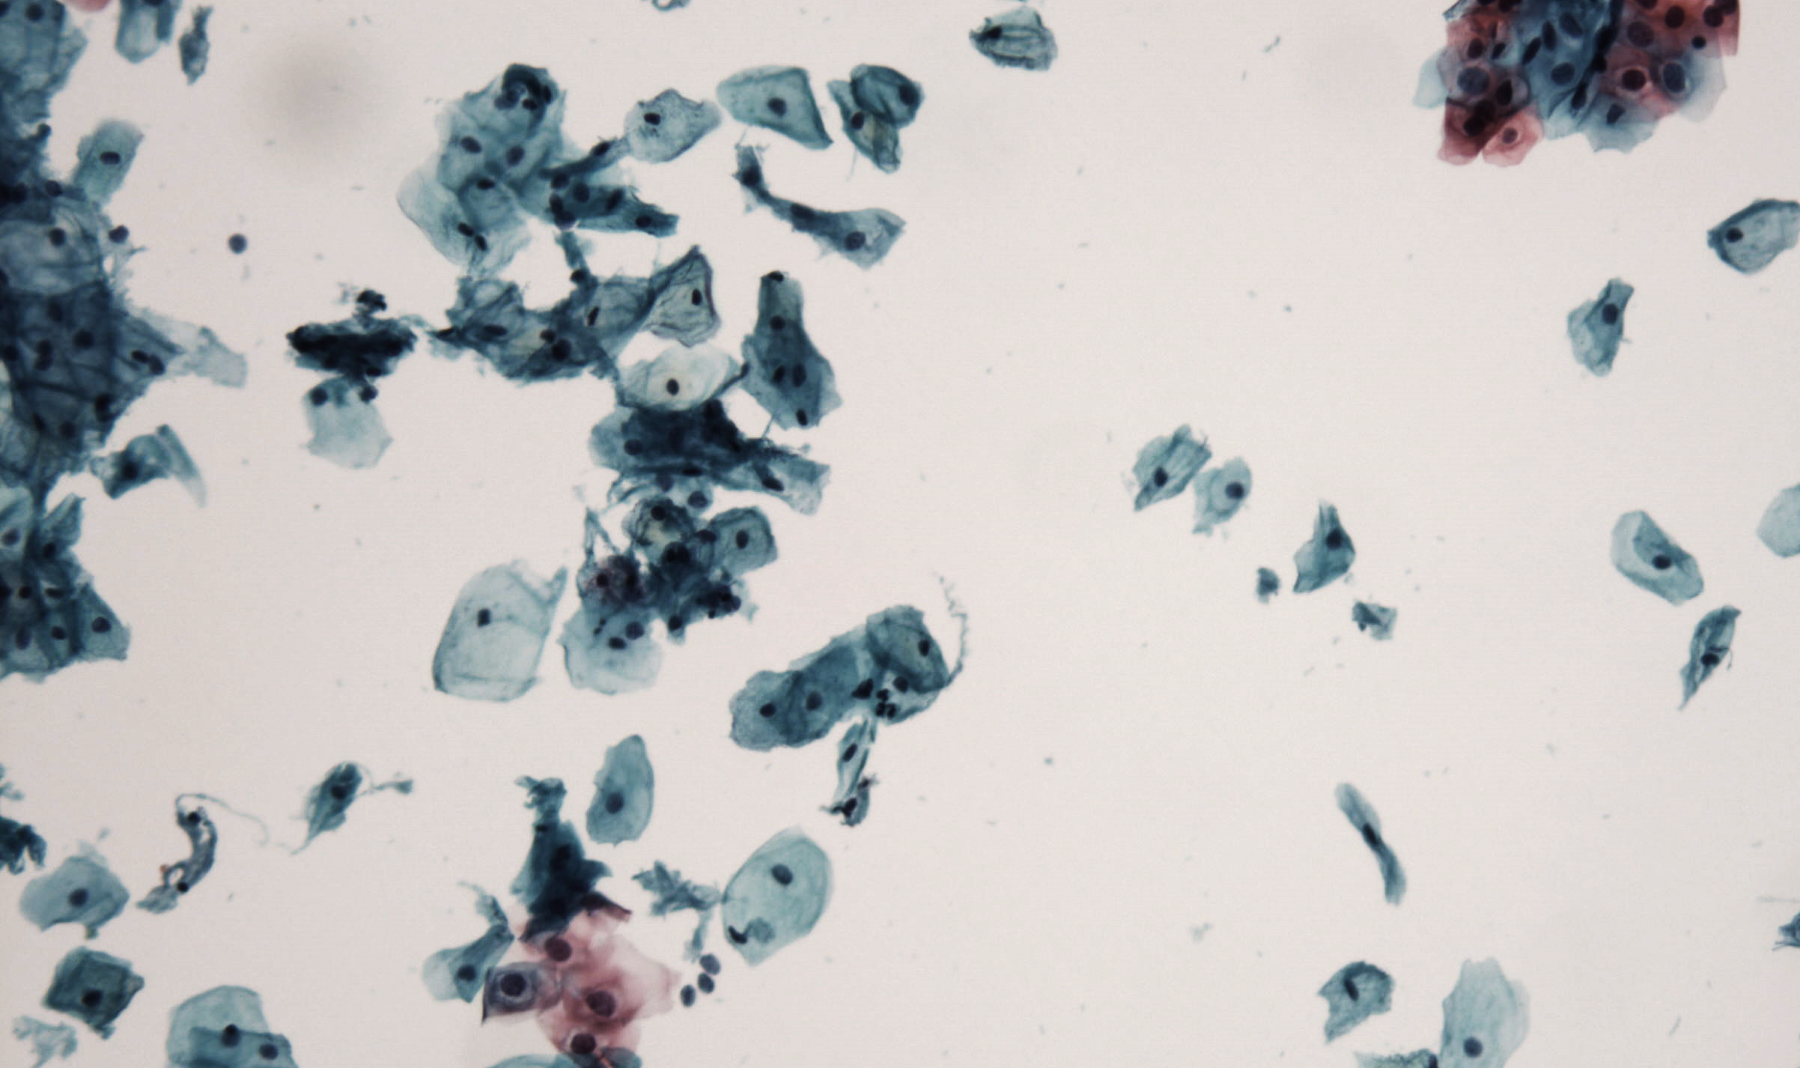
Prevention strategy conducted in AML
Monolayer technique: clean preparations
Monolayer preparations:
high sensitivity and specificity
retention of infectious agents, possible blood loss, etc.
Introduced in the market by: companies BD (Beckton & Dickinson) and HOLOGIC

Slide 17
Prevention strategy conducted in AML
Introduction of Bethesda classification for cytology: reporting categories
NILM: Negative for Intraepithelial Lesion of Malignancy
Epithelial abnormalities
Squamous cell:
Atypical squamous cells (ASC)
Low- grade squamous intraepithelial lesion (LSIL)
High- grade squamous intraepithelial lesion (HSIL)
Squamous carcinoma
Glandular cell:
Atypical Glandular cells (AGC), endocervical, endometrial or NOS
Atypical glandular cells favour neoplasti (AIS)
Adenocarcinoma
Other
or of undetermined significance (ASC-US)
cannot exclude HSIL (ASC-H)

Slide 18
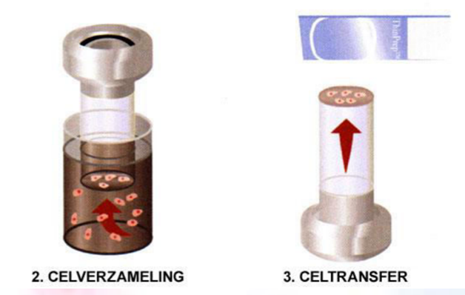
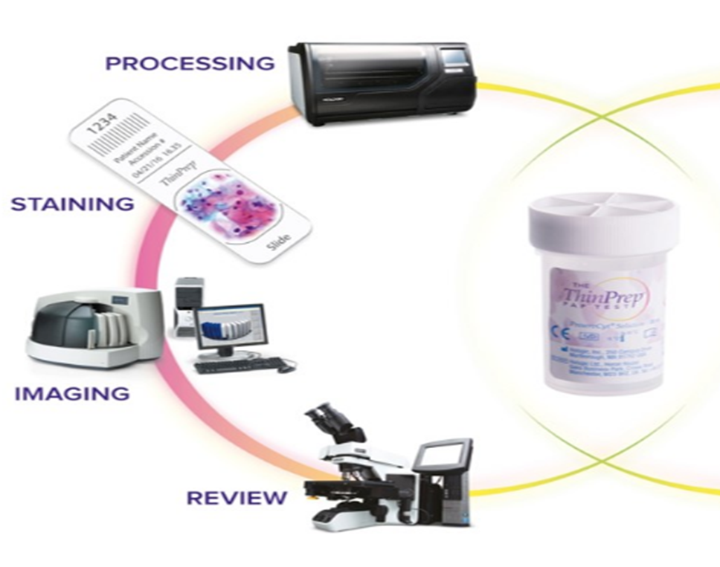
AUTOMATISATION: HOLOGIC: review microscope and GENIUS
Process flow from cell preparation to automation

Slide 19
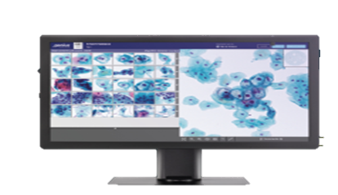
AUTOMATISATION: HOLOGIC: review microscope and GENIUS
Recent evolution: introduction of AI into the reading process - GENIUS review

Slide 20
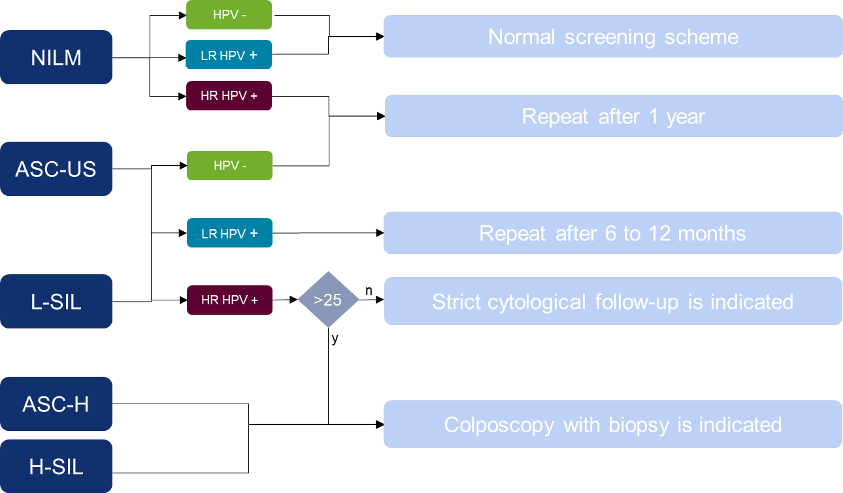
Prevention strategy in BELGIUMPrevention strategy: the Belgium experience (AML)
National reimbursed cytology screening scheme

Slide 21
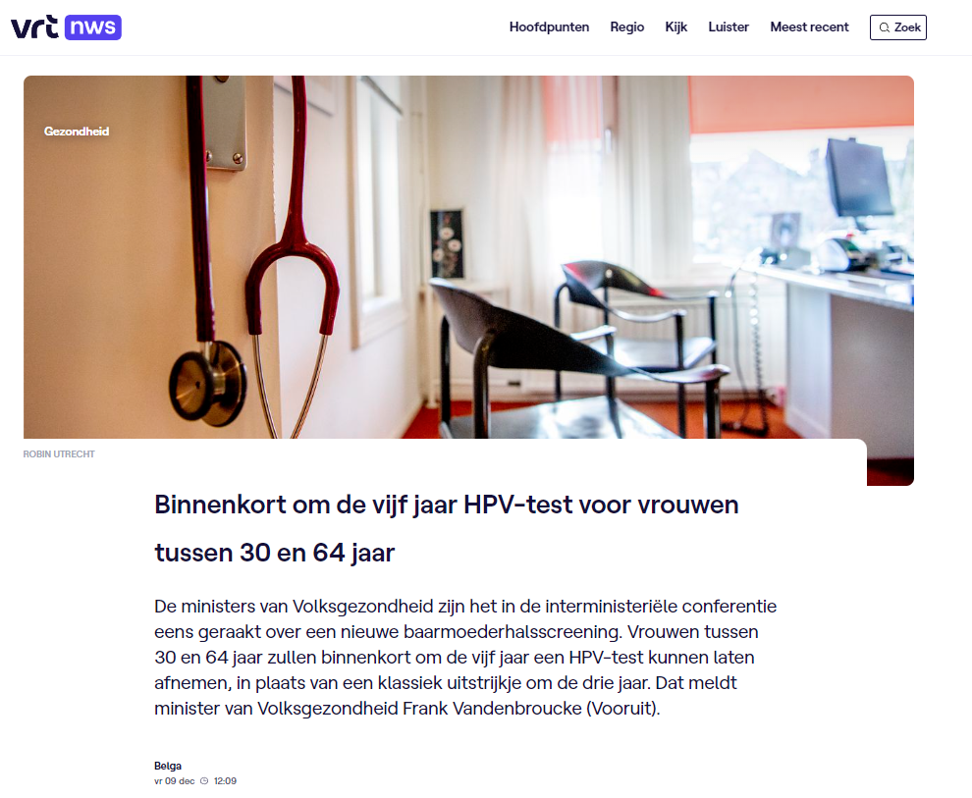


Prevention strategy: future outlook
Creation of National Reference Centers (NRC):
Steven Van Gucht, Michael Peeters
Bruno Verhasselt, Liza Padalko
JP Bogers, Kaat Kehoe, Davy Vanden Broeck
Notes:
Workgroup at Sciensano (Marc Vandenbulcke)
-Advise political stakeholders
-Exploratory discussions with
Pathologists/cytologists
Ob/Gyn
Virologists

Slide 22

Case study: co- testing HPV/Cytologyo-testing cytology and HPV
Case study: co-testing cytology and HPV
AML database (since 2006, more than 1M points) cross-over with Belgian Cancer Registy: 520 invasive cancer, 194 after 1/6/2006 and with at least one pap smear before the diagnosis of invasive cancer
194 cervical cancer cases
Mean age: 47,8 years (min 20 – max 86)
8,5% < 30 y – 19,1% < 35 y
 | CYTO normal | CYTO abnormal
HPV negative | 6 (3.1%) | 18 (9.3%)
HPV positive | 2 (1.0%) | 168 (86.6%)

Slide 23
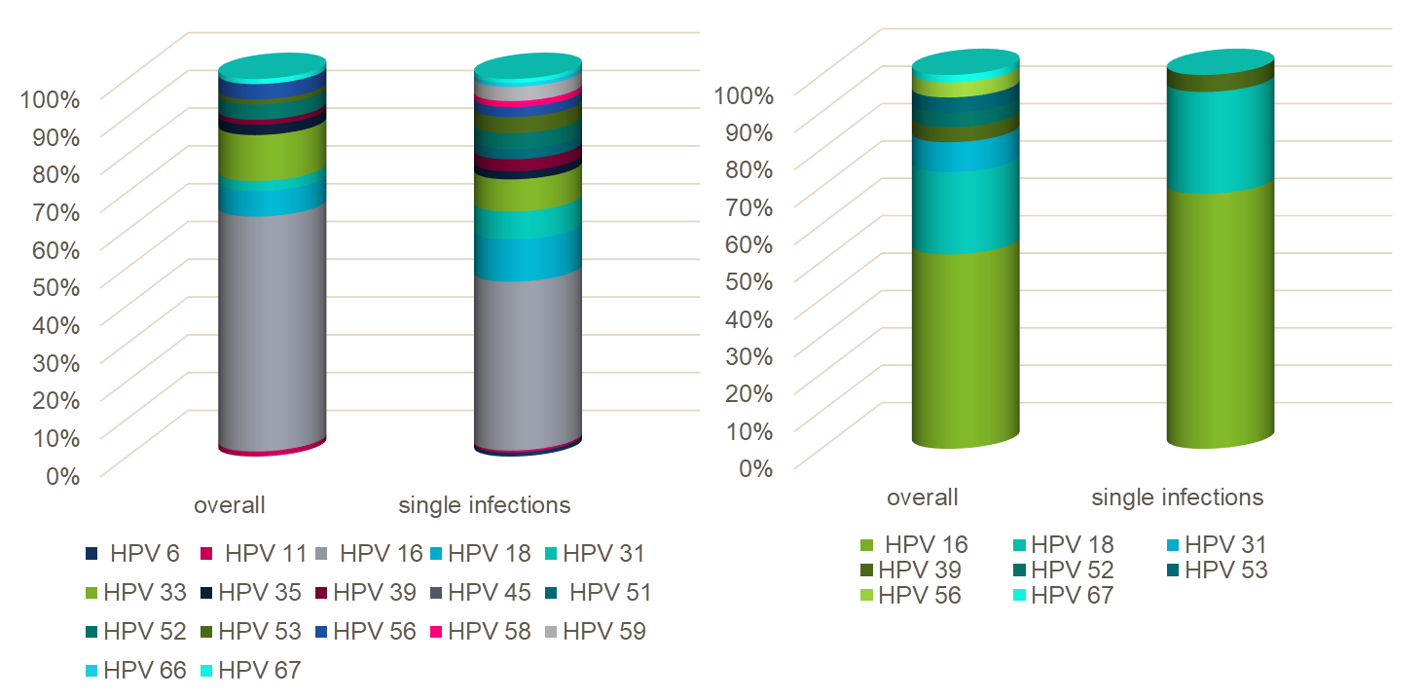
Case study: co- testing HPV/Cytologyo-testing Case study: co-testing cytology and HPV
HPV typing as a cancer biomarker:
145 SCC: 69% HPV16/18
49 ADCA: 71% HPV16/18

Slide 24


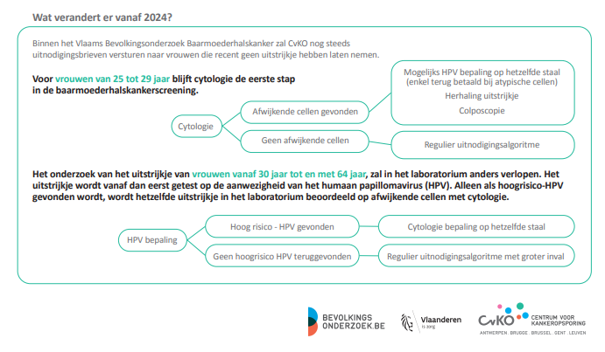
Prevention strategy: future outlook
National cervical cancer screening protocol: HPV-primary screening
24
A.M.L. – A Sonic Healthcare laboratory
Dr. Marleen Praet
24

Slide 25
Arguments against this future Cervical Cancer Prevention strategy
This prevention strategy would be perfect if:
- all cervical cancers would be positive for HPV
- all precursor lesions were positive for HPV
- all HPV assays were performant enough

Slide 26
Arguments against this future Cervical Cancer Prevention strategy
Detection of cancer: performance of the HPV assay test
Quest Diagnostics has calculated that 20% of the cervical cancers will not be detected
AML found in its own results going back to 2006 that 9.3 % of the cervical cancers or its precursor lesions is negative for HPVHR detection.
Only 86.6 % was positive associated with abnormal cytology either dysplasia or cancer. In squamous cancer only 69 % was positive for HPV16/18, in glandular cancer of the endocervix only 71% was positive for HPV16/18

Slide 27
Arguments against this future Cervical cancer prevention strategy
Strength and robustness of the technique of HPV determination:
Some high grade cervical lesions and cervical cancers(HSIL+) test negative for HPV evidenced through routine HPV based screening op through molecular epidemiological studies. The HPV- negative fraction reported by several laboratories varies between 0.03 and 15%. (Working Group from HPV Laboratory Network- WHO- Dillner 2023, submitted)
It depended on several reasons: pre-analytical (fixation, necrosis, bad sampling, few atypical cells), cytological misinterpretation( endometrial cancer misclassified as endocervical cancer, misinterpretation of reactive, inflammatory or atrophic changes as HSIL), assay- related issues (suboptimal extraction, HPV genotypes present in the lesion not covered by the HPV assay, HPV region targeted by the assay no longer present or variant nucleotide substitutions affecting efficiency of detection), true HPV negativity (HPV clearance before lesion clearance HSIL, lesions that have lost HPV (hit and run hypothesis, cervical cancers with different oncogenic pathway independent of HPV) (Working Group from HPV Laboratory Network- WHO- Dillner 2023, submitted)

Slide 28
Arguments against this future Cervical cancer prevention strategy
Cost
In the actual strategy the government pays for the prevention of cervical cancer 27 million Euro. Implementation of primary HPV screening will lead to a cost of 40 million euro,
Health Economic Modeling study (HE- study) has shown that this primary HPV screening + co-testing:
* result in the detection of 8573 CIN 2 and 6597 CIN 3 whereas by co-testing the number will increase to 10924 CIN 2 and 8199 CIN 3 cases
* cost 7650 Euro /CIN 2 case versus 5380 Euro with co- testing
cost 9942 Euro/CIN 3 case versus 7169 Euro with co- testing

Slide 29
Arguments against this future Cervical cancer prevention strategy
Mental and socio- economic stress for the women
Stress of the women that the HPVHR is positive will induce higher costs as more women will attend the gynecologist for colposcopy in search for certainty. This will increase these costs for the government.
Women are confronted with a changed schedule of having a cytology check – up after 5 years and fear to have developed a cancer during this period
More out- pocket costs for the women if they want any reassurance from their doctor..

Slide 30
Therefor the best strategy is: co-testing
All HPV negative (pre)cancers will be detected by cytology analysis. All endometrial cancers will also be detected
In AML patients pay for their HPV test (14 HPV types) 19 Euro and a cytology analysis costs 32 Euro.
Co- testing is done in Germany, Switzerland and Luxembourg

Slide 31



Acknowledgements
Dr. Pharm. Clin. Biol. Kaat Kehoe
Dr. Pharm. Clin. Biol. Jef Jonckheere
PhD. Rita Pereira
PhD. Nina Redzic
MSc. Lies de Baere
MSc. Dolores Maes
Davy Vanden Broeck, PhD.
Molecular Diagnostics
Sonic Healthcare Benelux
A.M.L. - Algemeen Medisch Laboratorium
Antwerp, Belgium
davy.vandenbroeck@aml-lab.be
Department of Ob/Gyn
Ghent University
Ghent, Belgium
davy.vandenbroeck@ugent.be

